Slide 1

CENTURION UNIVERSITY OF TECHNOLOGY AND MANAGEMENT
APPLIED DATA SCIENCE PROJECT
Facial Security Alert System
SUBMITTED BY:
M. SASI REKHA 211801380037
T.K.L NANDITHA 211801380033
I.NIHARIKA 211801380027
T.CHARISHMA 211801380010
SUBMITTED TO:
Mr. Amit Kumar
Asst Professor

Slide 2
ABSTRACT
Facial recognition technology is becoming increasingly popular in security systems, as it offers a more secure and convenient way to authenticate users. Facial security alert system that aims to improve the accuracy and reliability of facial recognition technology for security applications. The system is designed to continuously monitor a secure area and automatically generate alerts when an unauthorized or suspicious individual is detected. These alerts can be sent to security personnel or authorities for further action, ensuring a quick response to potential security threats. Overall, this system offers a powerful and reliable tool for improving security measures and protecting sensitive information, making it a valuable asset for any organization looking to enhance their security protocols.

Slide 3
INTRODUCTION
In this project, we will utilize a machine learning tool called Teachable Machine to develop a facial security alert system. Teachable Machine allows us to train a model to recognize and classify different facial features using a dataset of images. By providing the model with images of different individuals, we can teach it to distinguish between them and trigger an alert when an unauthorized person is detected. The system will work by capturing live video feed from a camera and processing it through the trained model. If a match is found between the detected face and the stored images of authorized individuals, no action is taken. However, if an unauthorized face is detected, an alert will be triggered, notifying the appropriate authorities.

Slide 4
COMPONENTS
Software Components Requirements
Spyder version -5
Teachable Machine
Hardware Components Requirements
Processor - Intel Core Duo 2 GHz
RAM - 2 GB Minimum Ram Required
OS - Windows 7 or Later

Slide 5
EXISTING SYSTEM
The existing system for an facial security alert system typically includes a setup where cameras are placed in various locations to capture facial images. These images are then processed by an AI algorithm that compares them to a database of known faces to determine if there is a match. If a match is found, the system alerts security personnel to take appropriate action.
Disadvantages :
1. Bias: AI algorithms can inherit the biases of the data they are trained on, which can result in discriminatory outcomes for certain groups of people.
2. Privacy concerns: The use of facial recognition technology raises significant privacy concerns, as individuals may not consent to having their faces scanned and stored in a database.
3. Security vulnerabilities: AI-based facial security alert systems may be vulnerable to hacking and manipulation, potentially leading to security breaches and unauthorized access.

Slide 6
PROPOSAL SYSTEM
In the proposed system using Teachable Machine, the process is simplified and made more accessible to users without technical expertise. Teachable Machine is a web-based tool developed by Google that allows users to easily train machine learning models without the need for coding knowledge. In this system, users can upload their own facial images, label them accordingly (e.g. employee, visitor, intruder), and train the machine learning model to recognize these different categories.
Advantages :
Simplified training process: Users can easily train the model by providing examples of different categories without the need for complex coding or machine learning algorithms.
Real-time facial recognition: The trained model can be deployed in a real-time system that can quickly identify individuals based on their facial features.

Slide 7
IMPLEMENTATION OF CODE
import cv2
import pywhatkit
import numpy as np
from tensorflow.keras.models import load_model
# Load the pre-trained Keras model and labels
model_path = r"C:\Users\priyanka\OneDrive\Desktop\Domain project\final\keras_model.h5“
label_path = r"C:\Users\priyanka\OneDrive\Desktop\Domain project\final\labels.txt“
model = load_model(model_path)
with open(label_path, 'r') as f:
labels = f.read().splitlines()
# Open a video capture object
cap = cv2.VideoCapture(0) # You can replace 0 with the video file path if you want to process a video file
# Set the resolution of the captured frame
cap.set(cv2.CAP_PROP_FRAME_WIDTH, 1920) # Set the width
cap.set(cv2.CAP_PROP_FRAME_HEIGHT, 1080) # Set the height
# Display the frame
cv2.imshow('Frame', frame) pywhatkit.sendwhatmsg("+918297709845", "This face is not in database!",20,53)
# Release the video capture object and close all windows
cap.release()
cv2.destroyAllWindows()

Slide 8
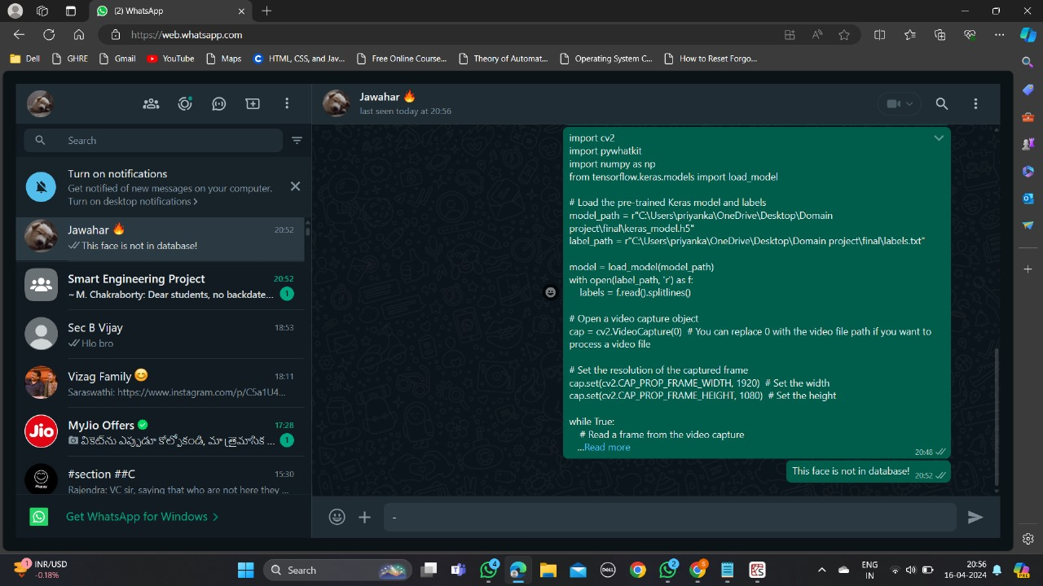
OUTPUT

Slide 9
CONCLUSION
In conclusion, the facial security alert system using Teachable Machine has proven to be an effective and efficient method for monitoring and identifying individuals in various security scenarios. The system's ability to accurately recognize faces and issue alerts in real-time has the potential to greatly enhance security measures in public spaces, residential complexes, and other environments where facial recognition technology is needed. With further advancements in machine learning and image recognition technology, this system can be continuously improved to provide even more reliable and robust security solutions. Overall, the facial security alert system using Teachable Machine shows great promise in ensuring safety and security in various settings.

